Slide 1
Welcome to the Basic Data Processing Track :)

Slide 2

EXCTING!!!

Slide 3
The importance of DATA

Slide 4



What is data…
According to the Oxford “Data is distinct pieces of information, usually formatted in a special way”. Data is measured, collected and reported, and analyzed, whereupon it is often visualized using graphs, images or other analysis tools.

Slide 5


RAW DATA...
Raw data (“unprocessed data”) may be a collection of numbers or characters before it’s been “cleaned” and corrected by researchers. It must be corrected so that we can remove outliers, instrument or data entry errors.

Slide 6

When can I say I have DATA..
01
02
03
04
Collect
extract
clean
visualize

Slide 7
What to Do With It?
This question can be answered in a single sentence: ''data helps you make better decisions''.

Slide 8



Benefits of Data,,,
Data Saves You Time
Identify Problems
BACK UP YOUR ARGUMENTS

Slide 9

DATA IS POWER!
https://youtu.be/77UPUxB2b7o

Slide 10
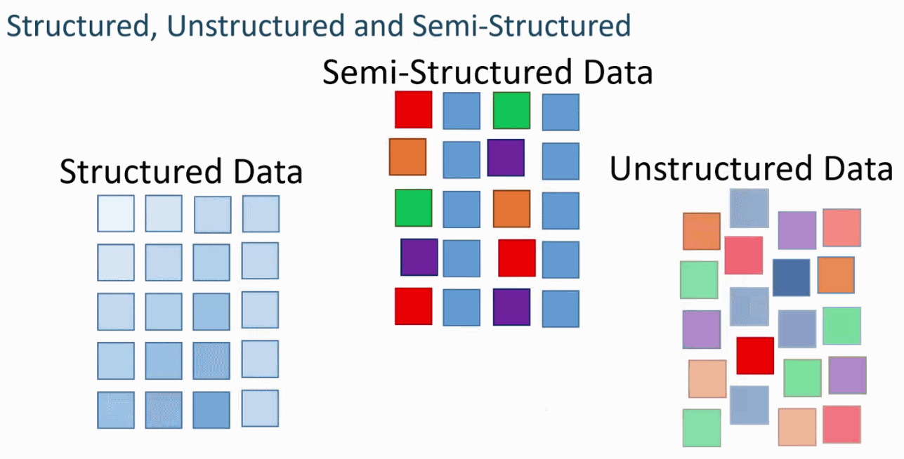
DATA Types...
01
02
03
Structured
Semi-structured
Unstructured

Slide 11
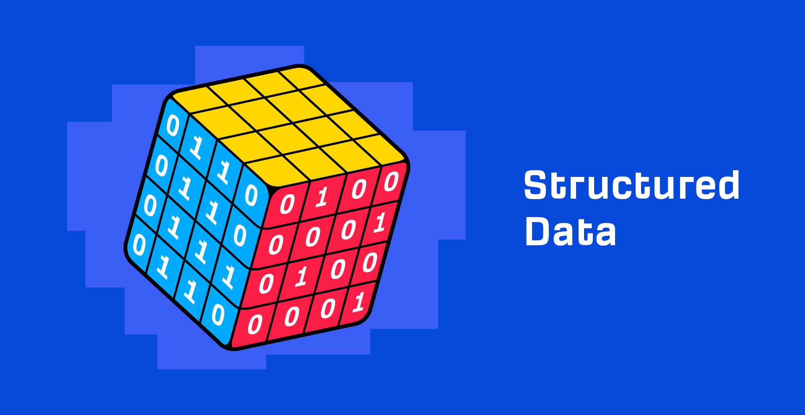
Structured Data
Data with a high degree of organization, typically stored in a spreadsheet-like manner.
Think of a spreadsheet (e.g. Excel)

Slide 12
Semi-structured Data
Data with some degree of organization
(HTML) files

Slide 13
Unstructured Data
Data with no predefined organizational form and no specific format
Plain text files

Slide 14
Data Sources

Slide 15
What is data sources…
A data source is the location where data that is being used originates from.
It can be a file, a particular database on DBMS, or even a live data feed.

Slide 16
Types of Data sources...
Primary data source: refers to the data originated by a researcher himself,
Examples:survey,questionaire,
observation,personal interveiws.
Secondary data source: refers to already exisitng data collected by agencies and organizations for the purpose of conducting analysis.
Examples:Government publications, staging websites,articles.
.

Slide 17
Where can I Find Data ?..
01
02
03
04
Databases
Flat Files
Social media
APIs and other platforms

Slide 18
Relevant data sources for industiral Artificial Intelligence,,,

Slide 19
Global Data sources: https://www.kaggle.com/ https://archive.ics.uci.edu/ml/datasets.php https://data.mendeley.com

Slide 20
Saudi Data sources: https://od.data.gov.sa/ar Also can be requested from the every government website

Slide 21

QUIZ
https://app.sli.do/event/eLnjnsKGtThWQB1mVaLroo/embed/polls/7b0e2453-a821-432d-b706-51eff05f7ed2

Slide 22
THANK YOU
Here’s an assortment of resources:
“What Is Data ?” GeeksforGeeks, 26 Apr. 2022, https://www.geeksforgeeks.org/what-is-data/.
?
?
?

